Slide 1
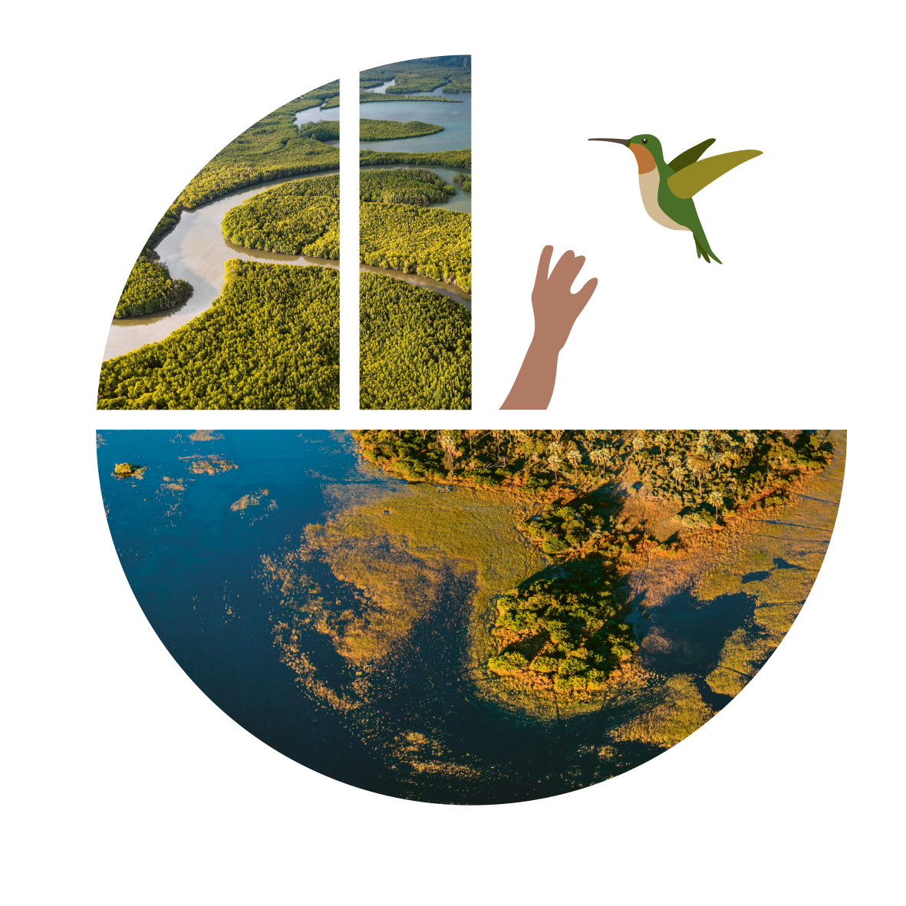
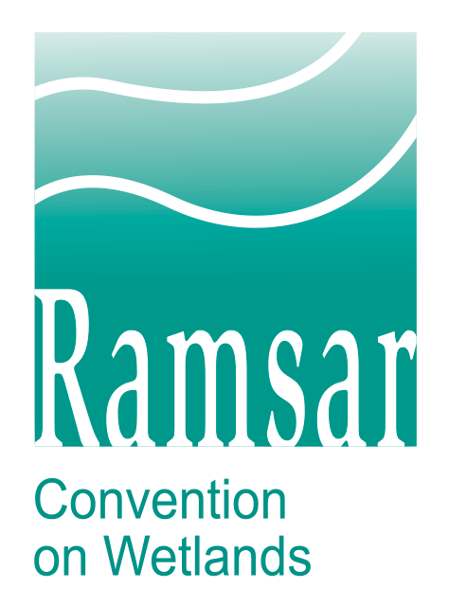
Life interlaced
Wetlands and people
CARE – NURTURE – SUPPORT

Slide 2
World Wetlands Day
A day to give voice to wetlands around the globe
An opportunity for all nations and people to come together to spur awareness, appreciation and action for wetlands.
A United Nations International Day since 2022.
Celebrated every 2 February since 1997 by Parties to the Convention on Wetlands.
Marks the anniversary of the Convention on Wetlands — adopted in 1971 as an international treaty.
First of the modern global multilateral environmental agreements.
Only one devoted to a specific ecosystem – wetlands.
Almost 90% of UN member states, from all the world’s geographic regions, have acceded to become “Contracting Parties.”
2024 Theme — Wetlands and Human Wellbeing
Spotlights how all aspects of human wellbeing are tied to the health of the world’s wetlands — physical, mental and environmental.
Elucidates how interconnected wetlands and human life have been throughout history — with people drawing sustenance, inspiration and resilience from these productive ecosystems.
Underscores the critical need for human stewardship of the world’s wetlands.

Slide 3
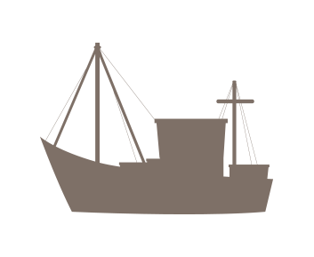
Wetlands and people have been intricately connected throughout human history.
The benefits that wetlands provide help sustain life and are central to human wellbeing.
WATER
FOOD
LIVELIHOODS
CLIMATE
CULTURE
BIODIVERSITY

Slide 4
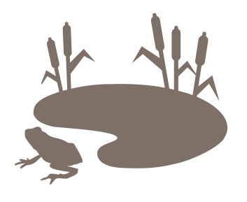
What are wetlands?
Wetlands are biodiverse and essential ecosystems
A major, planet-wide habitat that makes life on Earth possible.
Ecosystems, where water is the primary factor controlling the environment and plant and animal life.
Currently cover ~6% of the Earth’s land surface.
May be saltwater or freshwater, inland or coastal, natural or human-made, permanent or temporary, static or flowing.
Freshwater wetlands: rivers, lakes, pools, flood plains, peatlands, marshes, swamps
Saltwater wetlands: estuaries, mudflats, saltwater marshes, mangroves, lagoons, coral reefs, shellfish reefs
Human-made wetlands: fishponds, rice paddies, reservoirs, saltpans

Slide 5
Wetlands are essential for human life.
Our existence relies on water.
Yet, freshwater is scarce.
Only 2.5% of water on Earth is freshwater.
< 1% of Earth’s freshwater is accessible for direct human use.
Wetlands provide almost all our freshwater.
Wetlands silt-rich soil and plants naturally filter and store water.
Wetlands are known as the Earth’s kidneys.

Slide 6
Wetlands are essential for human life.
Wetlands are central to food security.
For thousands of years, people have established settlements near wetlands for access to fish, other food sources and freshwater for crops and livestock.
More than half of the world relies on wetland-grown produce for their staple diet.
>1 billion people worldwide rely on fish from wetlands as their primary source of protein.
Rice paddies feed 3.5 billion people annually.
Areas of extreme poverty throughout the world often rely on wetlands for food.
95% of inland fisheries’ catch occurred in developing countries, where it often plays a vital nutritional role.
The world’s irrigated agriculture area has doubled in 50 years.
70% of water withdrawals from the world’s wetlands are for agriculture.
Irrigation is particularly important in regions where rainfall is limited or irregular.
Aquaculture is the fastest growing food production sector.

Slide 7
Healthy wetlands advance human health.
Our health depends on well-functioning ecosystems — including wetlands.
According to the World Health Organization:
One Health is an integrated, unifying approach that aims to sustainably balance and optimize the health of people, animals and ecosystems.
It recognizes that the health of humans, domestic and wild animals, plants and the wider environment (including ecosystems) are closely linked and interdependent.
By linking humans, animals and the environment, One Health can help to address the full spectrum of disease control – from prevention to detection, preparedness, response and management – and contribute to global health security.

Slide 8
Healthy wetlands advance human health.
Wetlands offer services that promote many determinants of good health.
Clean water
Food security and nutritional variety
Clean air
Medicines
Climate stabilization
Protection against extreme weather
Healthy wetlands are essential for our ecological health.
Better managing the world’s wetlands can help provide clean drinking water, dramatically reducing ill health and infant mortality.
2.2 billion people are without safe drinking water.
485,000 die each year.

Slide 9
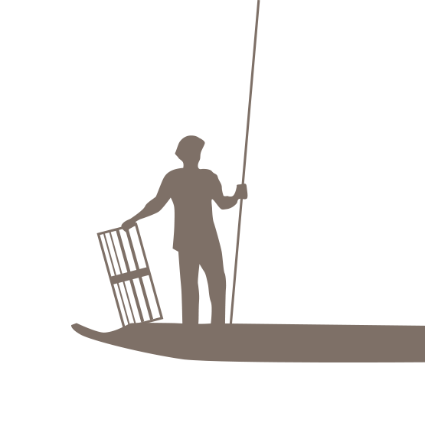
Healthy wetlands advance human health.
Wetland landscapes positively impact mental wellbeing, research shows.
The connection to nature that wetlands provide promotes mindfulness and a sense of emotional balance, contributing to improved mental health.
Wetlands provide recreational opportunities, including fishing, water sport activities and swimming, allowing people to relax and manage stress.

Slide 10
Wetland biodiversity promotes human wellbeing.
As vital reservoirs of biodiversity, life thrives in wetlands.
Each ecosystem type contributes uniquely to the planet’s overall biodiversity by supporting plants and animals specially adapted to living in particular conditions.
Wetlands are one of the world’s most biodiverse habitats, provide homes for many endangered species and offer a lifeline for freshwater species.
40% of the world’s plant and animal species live or breed in wetlands, including:
>100,000 freshwater species, with 200 new ones discovered each year.
30% of all known fish species.
Many endemic species are found only in specific wetland areas.
Rivers and streams carry the rich nutrients found in wetlands to power the greater food chain.
Wetlands’ rich biodiversity underpins quality of life for people around the world.
Provides food security, quality and nutrition.
Supplies medicines.
Boosts business and industry.
Guards against floods and other climate events.
Protects against disease by ensuring healthy ecosystems and safe spaces for wildlife away from human habitats.
Helps ensure our harmonious coexistence with nature.

Slide 11
Wetlands contribute to economies around the world.
Wetlands provide jobs and help eradicate poverty.
About 1 in 8 people (>1 billion worldwide) make their livelihoods from wetlands in ways that also deliver food, water supplies, transport and leisure.
Rice farming is the primary source of wetlands employment; ~80% of the world’s rice is produced by small-scale farmers.
>660 million people depend on fishing and aquaculture for a living.
The travel and tourism sectors support 266 million jobs, accounting for 8.9% of the world’s total employment.
Roughly half of international tourists seek relaxation in wetland areas, especially coastal zones.
Rivers and inland waterways are essential to the transportation industry.
Vast networks and large workforces deliver freshwater and remove and treat wastewater.
These economic opportunities often benefit indigenous populations.
Traditional wetland livelihoods entail harvesting and processing medicinal plants, dyes, fruits, reeds, and grasses, especially in developing countries.
Wetlands offer water sources for livestock grazing, supporting farmers and herders in maintaining a consistent water supply for their animals.
Wetlands provide freshwater for industry, which uses 19% of the water withdrawn.

Slide 12
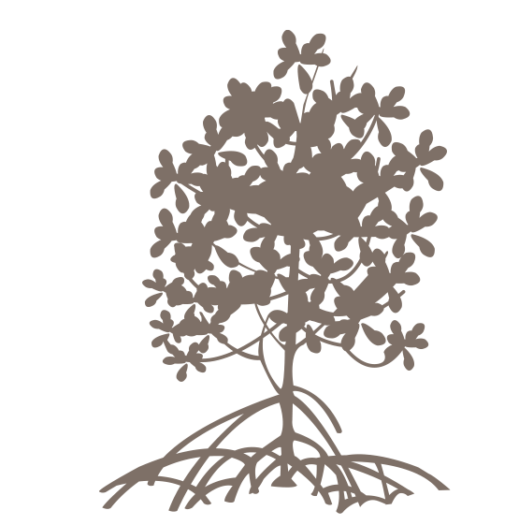
Wetlands protect against climate change.
Wetlands help us mitigate and adapt to climate change and its impacts.
Wetlands safeguard the 60% of humanity along coastlines against storm surges, hurricanes and tsunamis.
Each acre of inland wetlands absorbs up to 1.5 million gallons of floodwater, helping to reduce floods and delay and relieve droughts.
Wetlands store more carbon than any other ecosystem on Earth.
Blue carbon ecosystems provide critical CO₂ storage in vegetation, soils and sediments and are among the most valuable ecosystems in regulating the global climate.
These include mangrove forests, intertidal marshes and seagrass beds.
Peatlands cover only 3% of global land but store ~30% of land-based carbon — twice the amount of all the world’s forests.
Coastal wetlands, flooded regularly by tidal waters, sequester and store carbon up to 55 times faster than tropical rain forests.

Slide 13
Wetlands are a cherished part of cultural and spiritual life.
Wetlands have inspired the creative and spiritual minds of humans from the earliest times.
Places where water was abundant became the seats of great civilizations.
River Nile for the ancient Egyptians
Euphrates and Tigris for the Mesopotamians
Mekong for the Khmer Empire
As the bringer and sustainer of life, water has been venerated down the ages and plays an important role in the world’s major faiths.
Buddhism, Christianity, Hinduism, Islam, Judaism, Sikhism
The scenes and associations of wetlands have contributed to the artistic heritage of perhaps all cultures around the world – from local and national to classical Western tradition.
People living near wetlands have developed socio-cultural values around these ecosystems that are integral to their culture, spiritual life and current existence.
Song, dance and stories as collective expressions of respect and reverence towards wetlands are rich traditions that remain part of everyday life for many of the estimated three million indigenous people living within at least 5,000 distinct cultures worldwide.

Slide 14
We, the representatives of Central American peoples from Belize to Panama, consider our wetlands to be of vital importance as the source of life for present and future generations, providing us with abundant water and a wealth of flora and fauna that can be used as food and natural medicines.
They are also a source of income that must be used sustainably. This is why we all need to unite our efforts and pursue improved quality of life for our communities, and promote activities such as tourism.
By conserving our landscapes with their natural beauty, they will continue to be a source of artistic inspiration.
Our wetlands provide opportunities for research and study that enrich science and universal culture.
They should have the support of local, regional and international organizations, because they are lungs with great world importance, generating pure air. At the same time they are natural filters that reduce pollution and soften the pounding of natural phenomenon.
It is thus everyone's obligation as individuals, and as organized forces, to defend, care and maintain them in perpetuity.
―Declaration of the Central American People and Wetlands who live near Ramsar sites in Mesoamerica, May 12, 1999

Slide 15
Our wetlands are in jeopardy.
Wetlands are the Earth’s most threatened ecosystem. Their role as reservoirs of biodiversity is under siege.
Wetlands are being lost three times faster than forests.
More than 80% of all wetlands have disappeared since the 1700s.
The trend is accelerating. Since 1970, at least 35% of wetlands have been lost.
Human wellbeing, livelihoods and the health of the planet are at stake.
The triple planetary crisis of climate change, nature loss and pollution is harming human health.
Wetland species are facing the risk of extinction.
They’re declining faster than those from other ecosystems.
One in three freshwater species and 25% of all wetland species face extinction from wetland decline.
81% of inland wetland species and 36% of coastal and marine species have declined in the last 50 years.
Human activities and climate change are driving degradation.
Agriculture continues to be a primary driver of wetland loss and degradation. Wise use is essential for their sustainability.
Water and plastic pollution and overfishing are harming wetland ecosystems, along with invasive species.
As cities grow and the demand for land increases, development encroaches on wetlands.

Slide 16
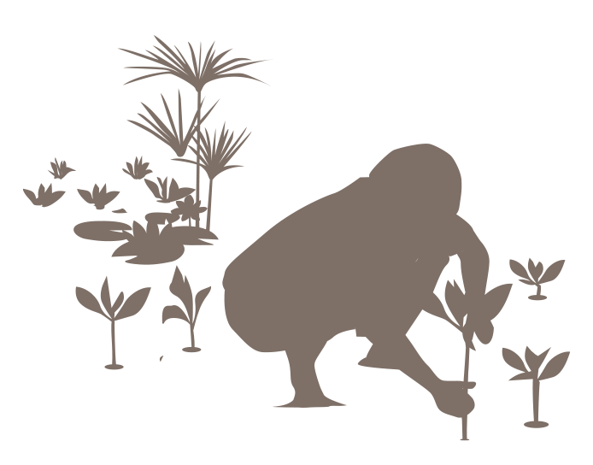
We must act now. Together.
Taking positive actions for wetlands today will help protect human wellbeing tomorrow.
Wetlands sustain human wellbeing as natural guardians against pollution, as integral components of resilient urban planning and restoration, and as vital contributors to the broader concept of One Health.
You can:
Understand the significance and contributions of wetlands.
Ensure their sustainable use by managing them wisely.
Attract the investments needed to conserve and restore them.
The UN Decade on Ecosystem Restoration (2021-2030) is a call for the protection and revival of ecosystems around the world for the benefit of people and nature.
The Convention on Wetlands is a global partner and recognizes that the restoration of the Earth’s wetlands must be a key priority for ensuring a sustainable future.
The initiative represents a distinct and timely opportunity to join efforts and make meaningful headway worldwide in preventing, halting and reversing the degradation of our planet’s wetlands.
Join the global effort to care, nurture and support the world’s wetlands – for the wellbeing of present and future generations.

Slide 17
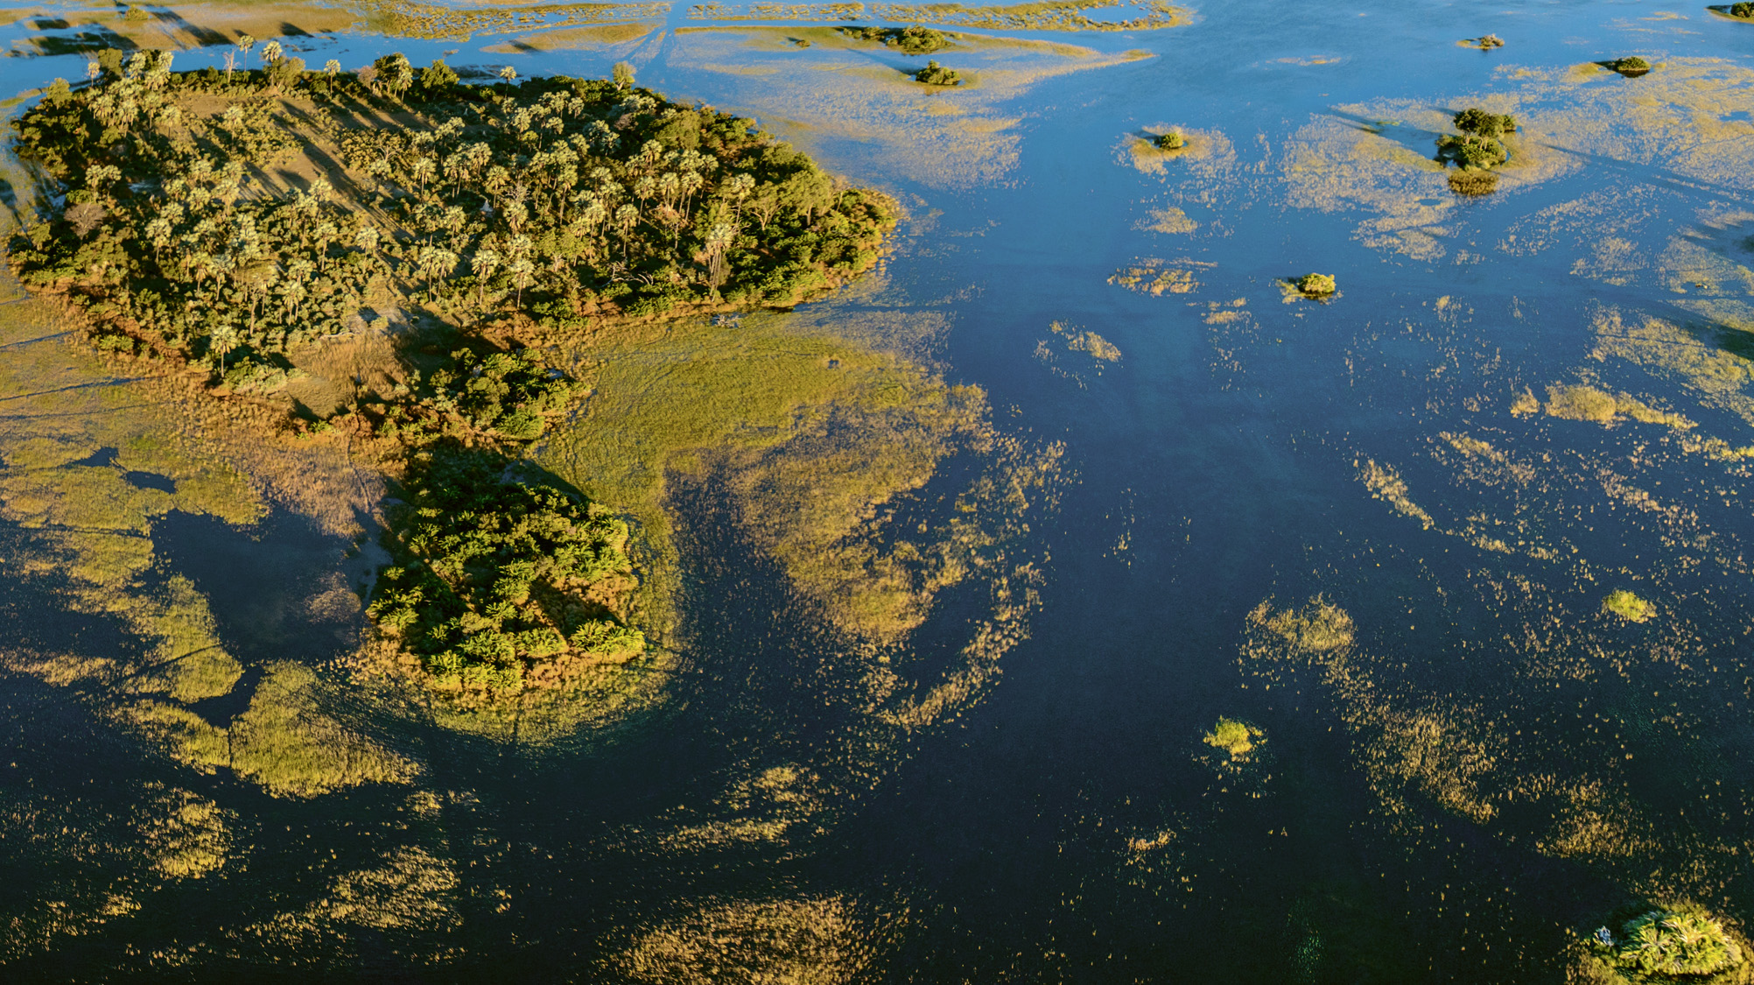
Every wetland matters.
Every effort counts.

Slide 18
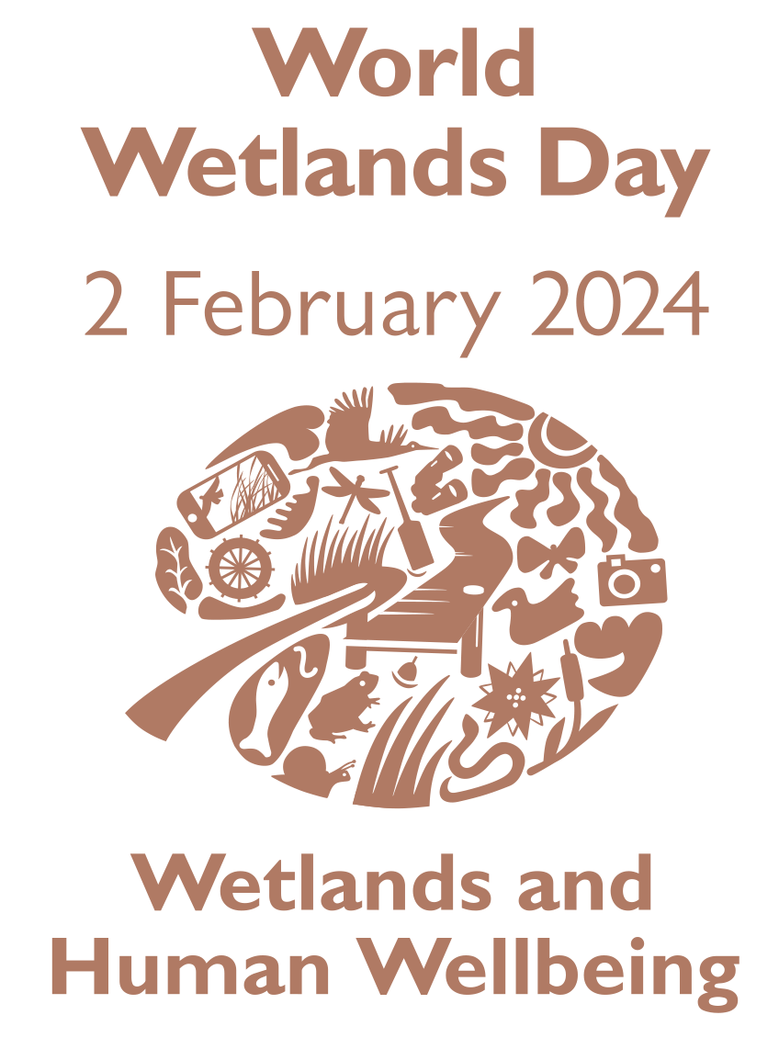
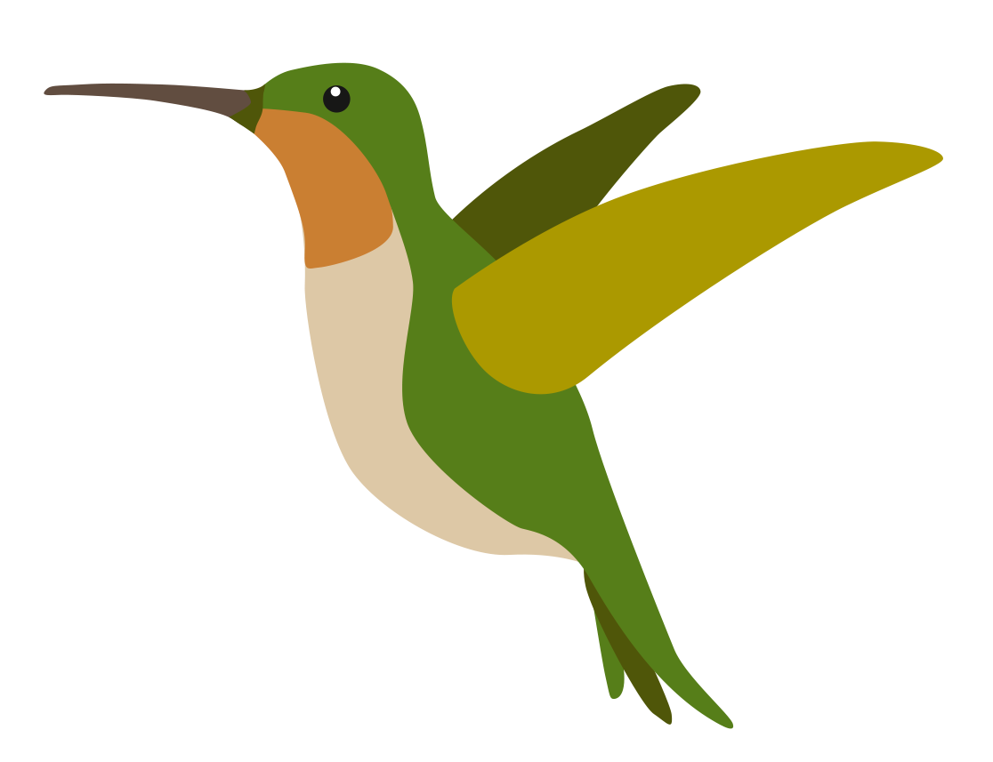
“I enter the swamp as a sacred place — a sanctum sanctorum. There is the strength, the marrow, of Nature.”
– Henry David Thoreau
#ActForWetlands

